Slide 1
Engaging, retaining, and graduating linguists: Some thoughts about how to bring up the next generation
Laura A. Janda

Slide 2
Overview
Overall ideas
Specific examples
Up to date
Technology
Engaging
Applicable
Conlangs
Social media
Statistics
Language technology
Language teaching
Other ideas

Slide 3

Conlangs
One has to learn a lot of linguistics in order to create or learn a constructed language
Interest in conlangs has blossommed, thanks in part to series like Game of Thrones
The conlangs subreddit “Constructed Languages for Language Geeks” has over 57,000 followers and a very professional resource page (WALS, Leipzig Glossing Rules, IPA, Index Diachronica, SIL software)
I will be teaching a new BA course on conlangs Spring 2021, HIF-1022 (no prerequisites)

Slide 4

Social media
Cyber attacks and influence campaigns are considered to be the greatest modern threat to societies
Linguistic analysis of social media in uncovering, understanding, and making citizens more resilient to mis- and disinformation
Reference corpora can reveal language that deviates from “neutral”
“Market basket” analysis can identify trends in problematic information
See our Threat Defuser project

Slide 5

Statistics
I have been teaching an MA-level introductory statistics course since 2015, HIF-3082
Aim is for basic literacy/numeracy and ability to apply and interpret core statistical models
Currently preparing an update to include Winter’s Statistics for Linguists and R markdown
Statistics is more meaningful when you collect and analyze your own data, but this makes for a very labor-intensive course

Slide 6
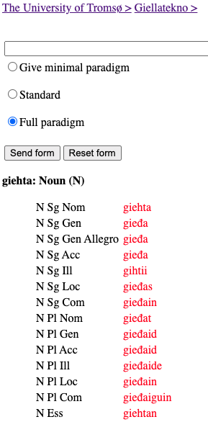
Language Technology
Creation of NLP applications, corpus resources, etc. for languages
Especially for “small” languages, minority languages, indigenous languages
Young people are digital natives and many can dive right in
Cf. Giellatekno

Slide 7
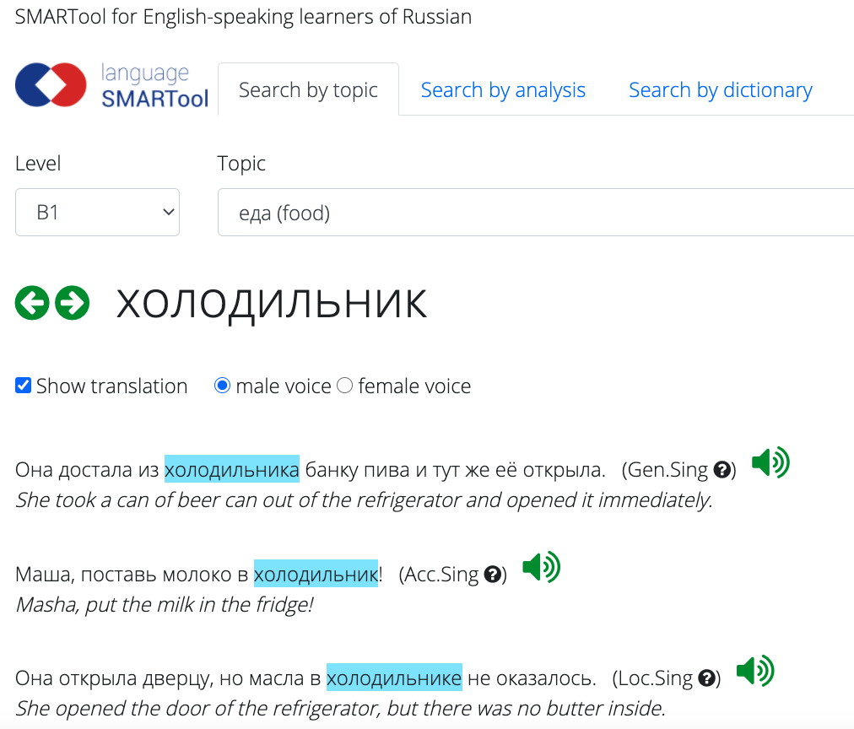
Language teaching
Creation and gamification of electronic learning resources
These can combine skills from statistics and language technology
For example, SMARTool: Strategic Mastery of Russian Tool
full version
lessons for Min russiske reisen

Slide 8
Other ideas
Courses
Activities
Typology
Psycholinguistics
Metaphor
…
Research assistantship/internship
Co-authorship
Community based awareness

